Slide 1

FPNN: Field Programmable Neural Network
Based on Bernard Girau’s Paper: FPNA: Applications And Implementations
Urs Evora
Omair Arif
Stefan Cherubin
Steven Lee
Final Presentation

Slide 2
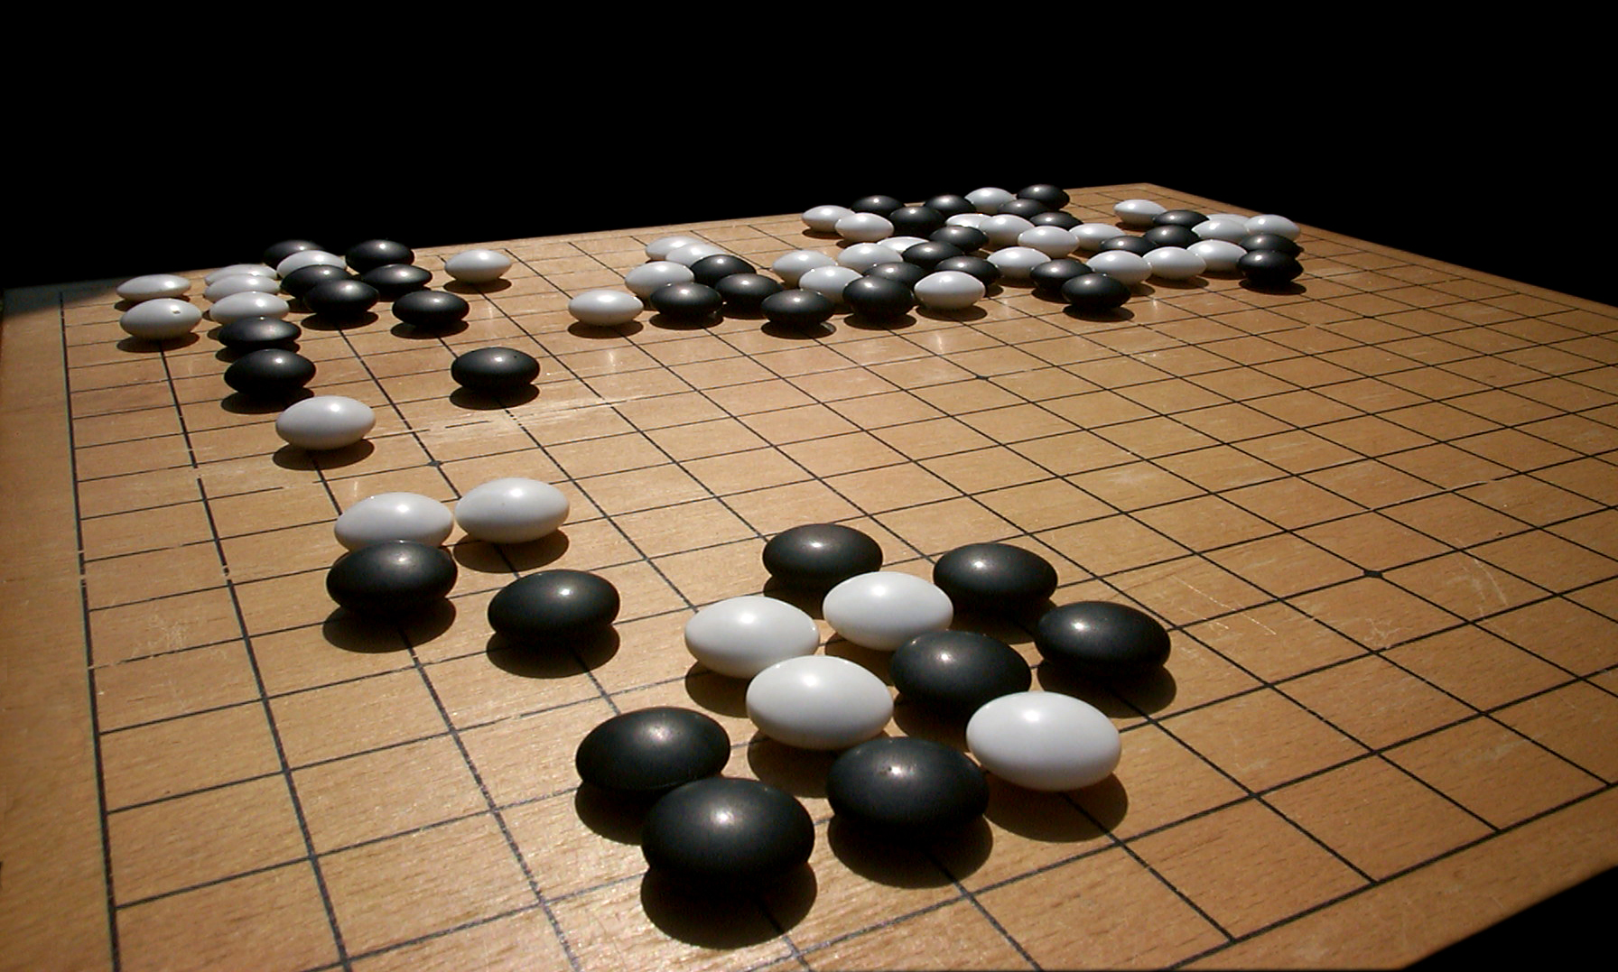
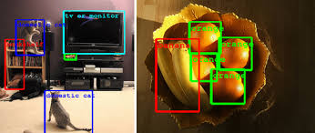
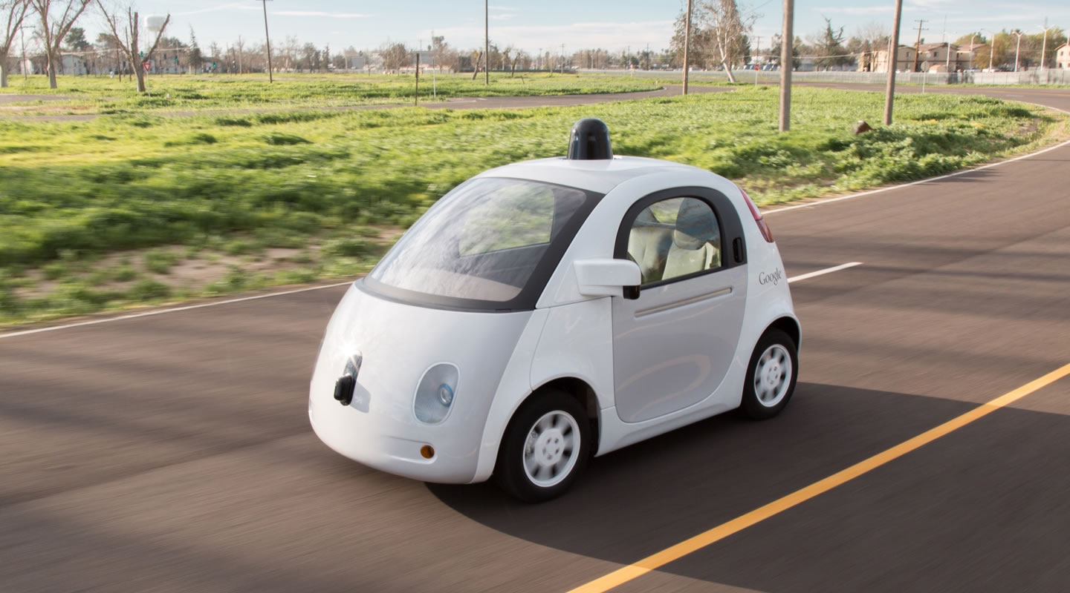

Applications
AlphaGo
Image Recognition
Stock Prediction
Self-Driving Cars

Slide 3
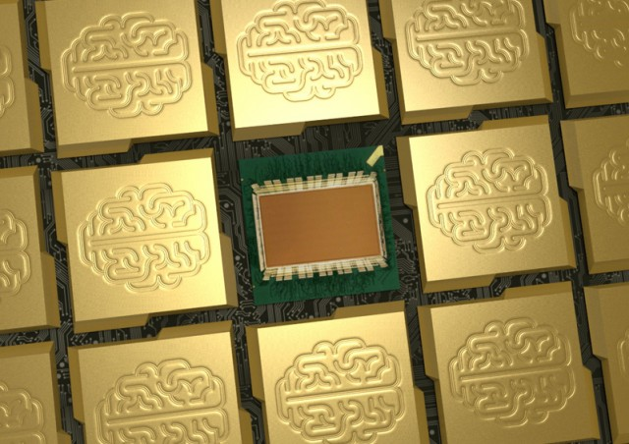

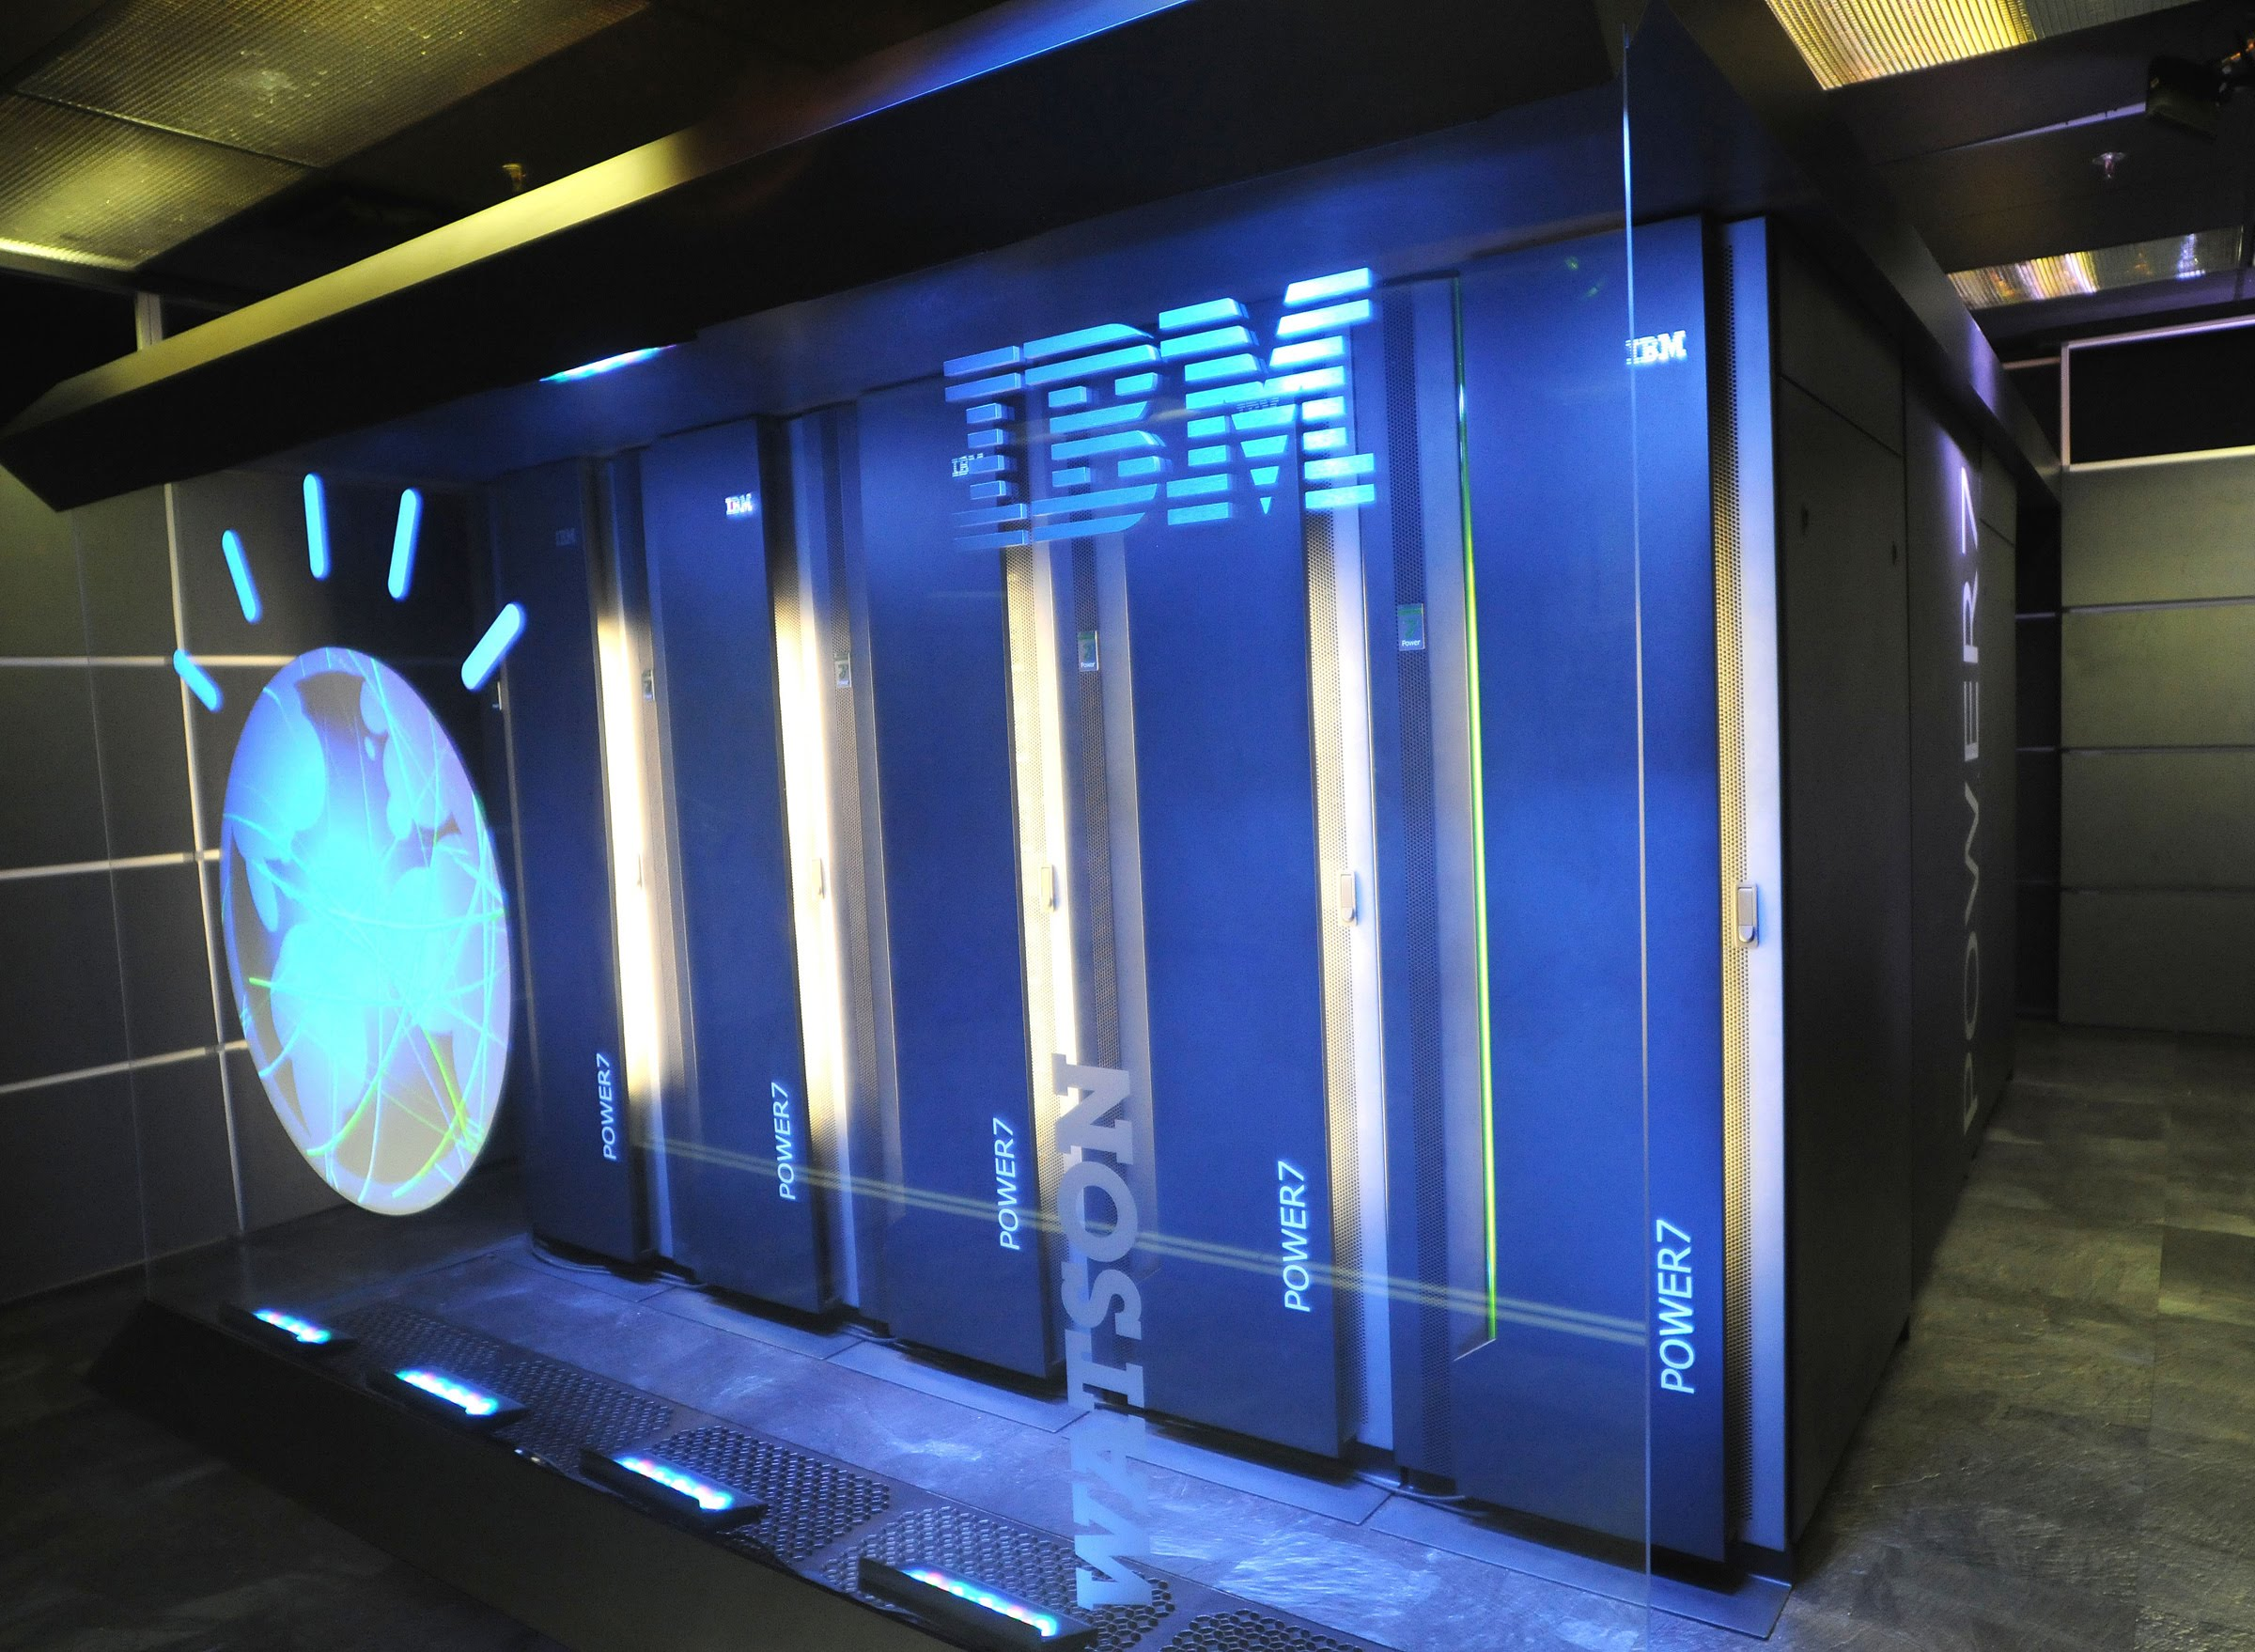
Current Implementations
IBM: TrueNorth ASCI
IBM: Watson

Slide 4
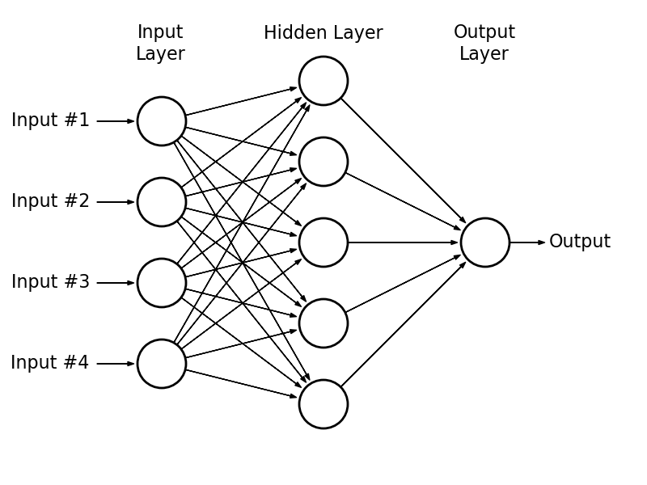
Multilayered Perceptron (MLP)
Neurons
Synapse

Slide 5
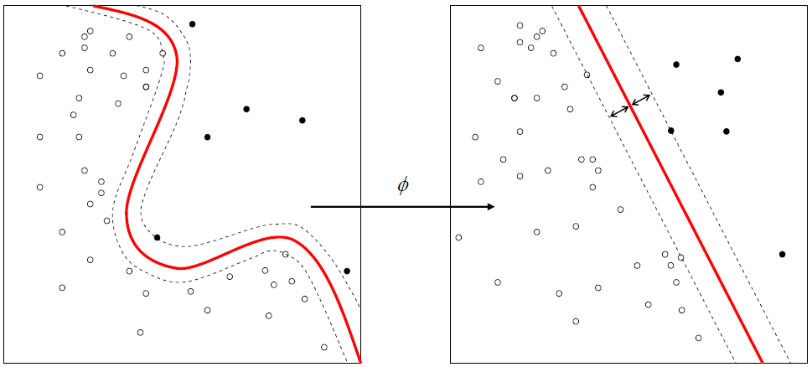
How it works

Slide 6
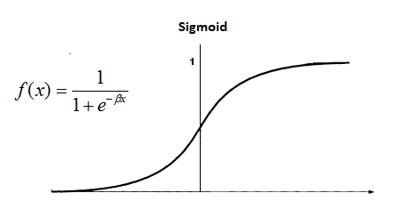
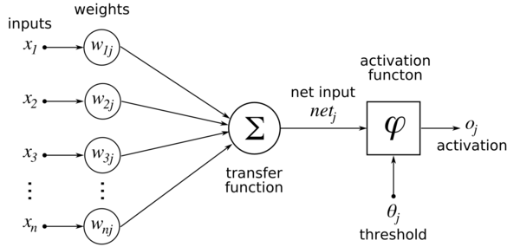
Forward Activation

Slide 7
Learning...
Training set
Classify with training set (forward activation)
Adjust Weights (Back propagation)
Repeat 1-3 until accurate

Slide 8
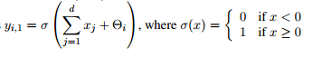
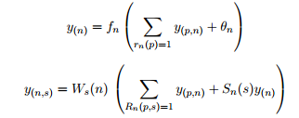
Back Propagation
(The Hard Part)

Slide 9
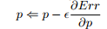
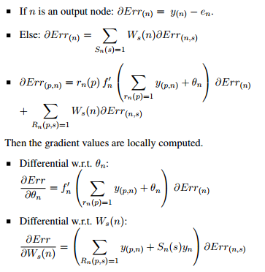
Back Propagation
(The Hard Part)

Slide 10

The Challenge
n neurons
n² synapse!

Slide 11
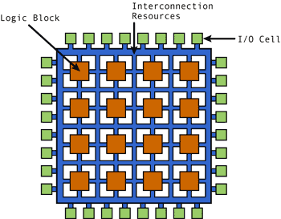
FPGA Structure

Slide 12
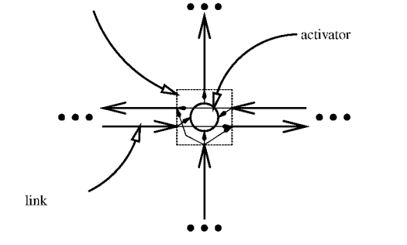
The Solution

Slide 13
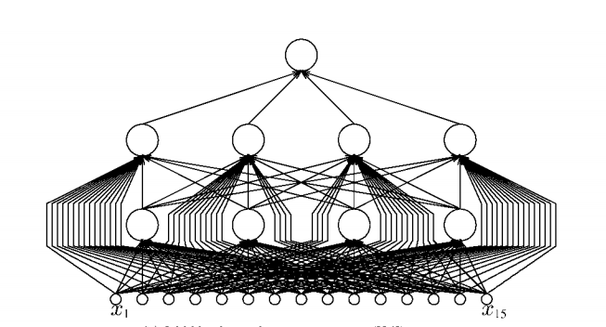
We can turn THIS

Slide 14
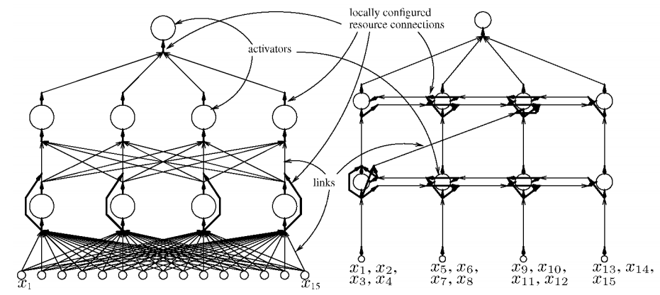
Into This!

Slide 15
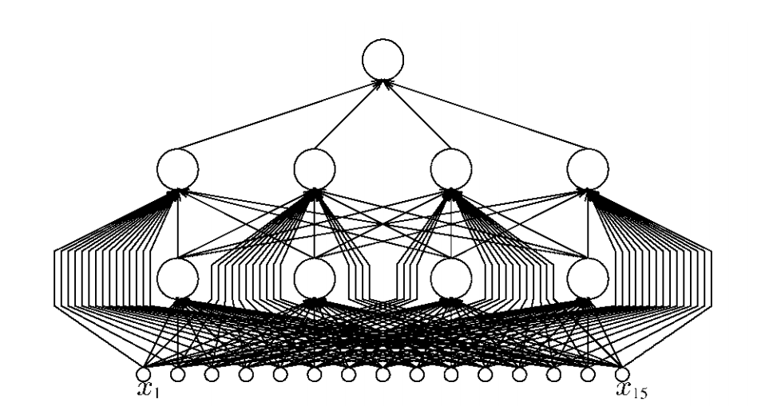
Problem Recap
N Neurons
N² Synapse connections
Fan-in/Fan-out
FPGA has a grid structure
Connections are expensive
Parallelism

Slide 16
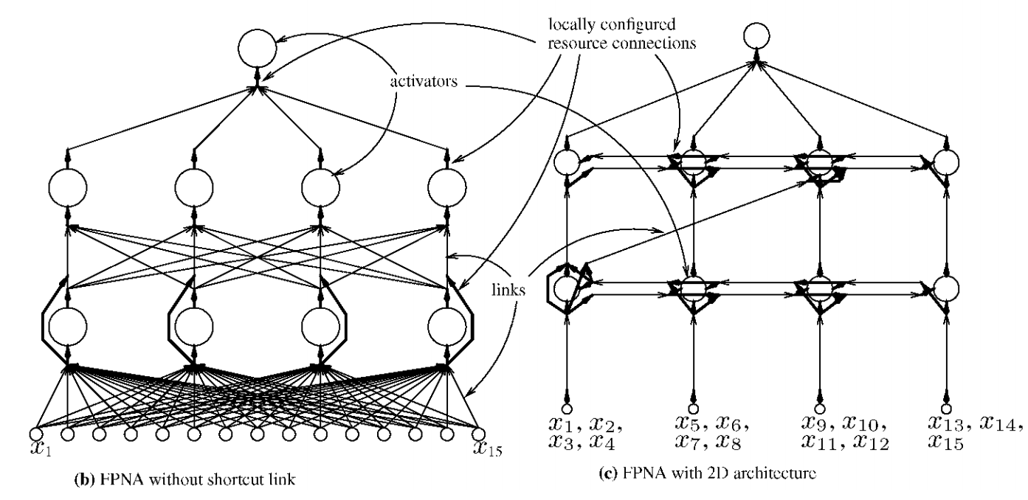
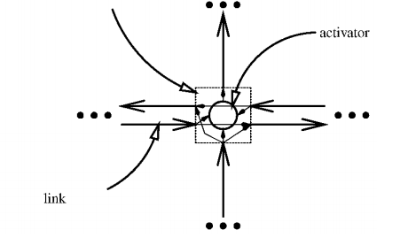
General Solution

Slide 17
Advantages
Reconfigurable networks
Takes advantage of increasing FPGA density
Scalability
Lower development time
Software based configurability (VHDL/HLS)
Easily deployable unlike VLSI

Slide 18
Neuron
North L
East Ports
West L
West Ports
ACT
East L
South Ports

Slide 19
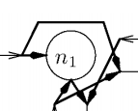
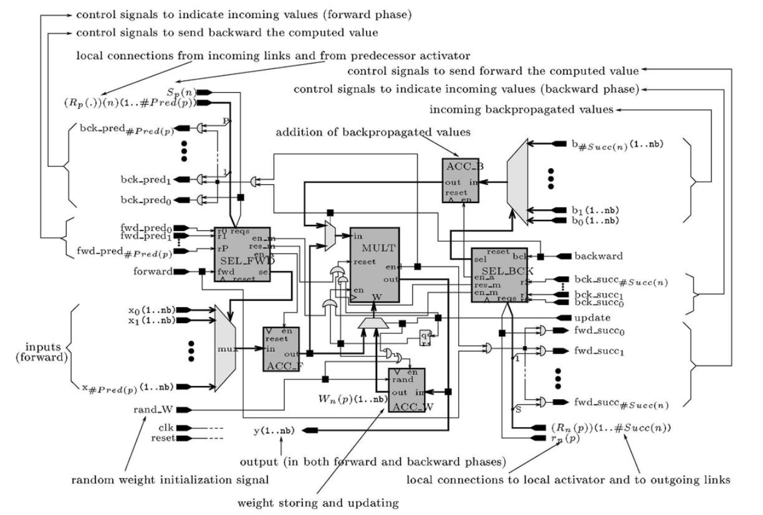
Links (Synapse)

Slide 20
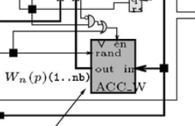
ACC_W (Accumulator of Weights)
Stores weight for each link
Adds ΔW to W
random initial value
Overflow?

Slide 21
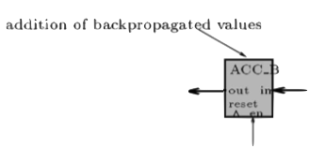
ACC_F/ACC_B (Accumulator of Forward/Back Propagated Values)
Functions
Adds and stores the back propagated values
Passes result to next stage
20-bit
Issues
Overflow

Slide 22
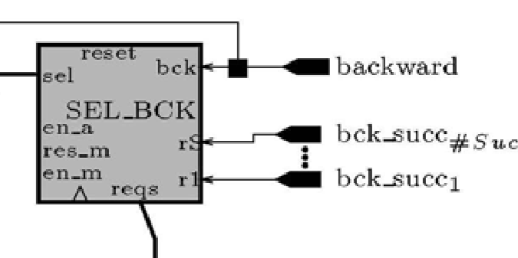
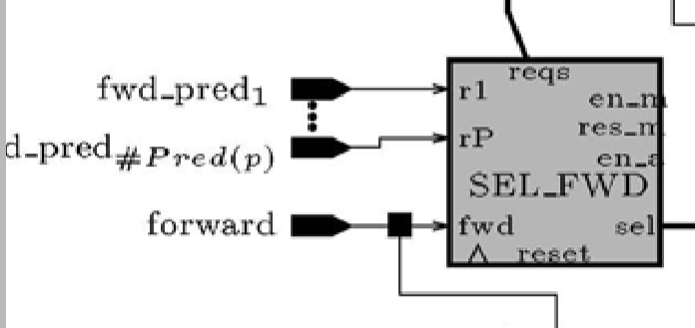
SEL_FWD/BCK (Select Forward/Backward)
Selects a request signal so that the ACC_F module calculates the corresponding value
Once all expected values have been received, en_m is set to active so that the MULT can begin multiplying the local weight by the value obtained in ACC_F

Slide 23
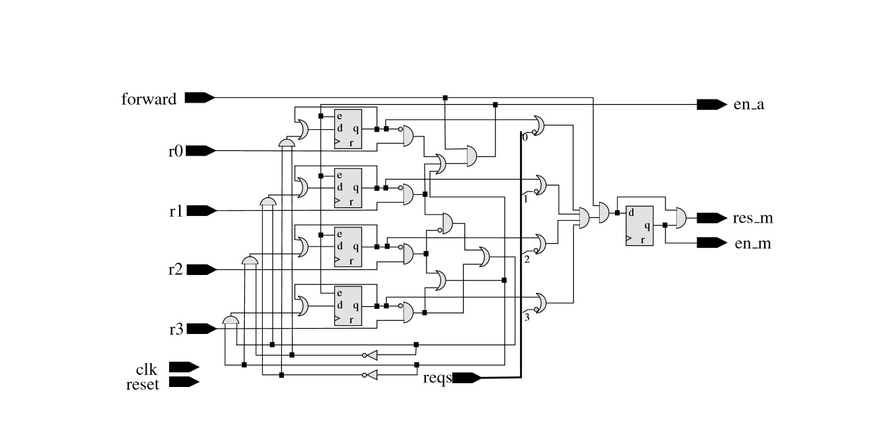
Selector (SEL) Gate Diagram
4-to-2 Encoder
Sel

Slide 24
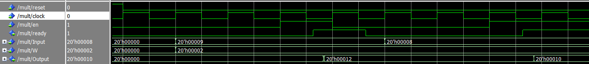
MULT (Multiplier)
20 bit fixed point multiplier
Takes input from ACC_F and ACC_B
Takes Weight form ACC_W
Takes reset and enable from SEL_F and SEL_B
performs Multiplication between input and weight
sends result to ACC_W and output
Sends a completion signal out to indicate to bck_pred and fwd_succ that link is complete

Slide 25
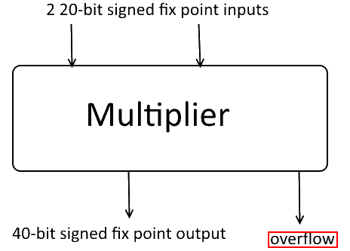
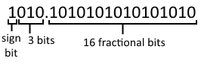
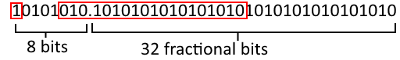
The Multiplier

Slide 26
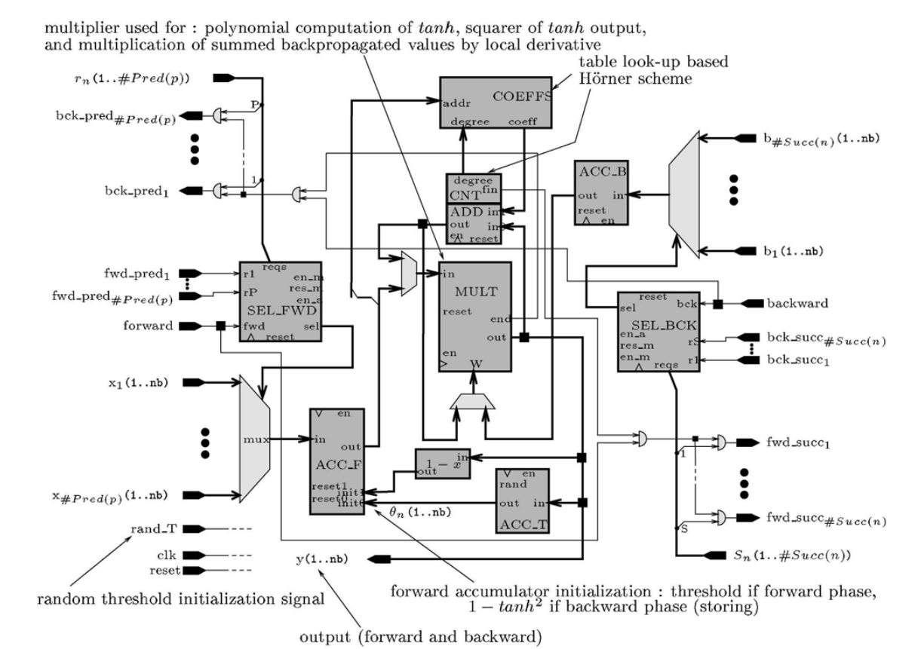
Activator

Slide 27
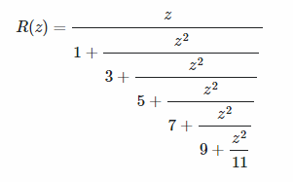
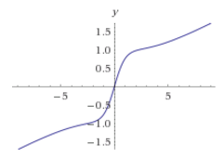
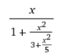
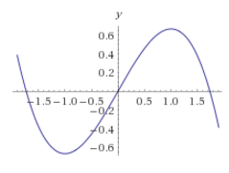
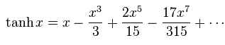
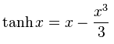
Honer Scheme & Tanh(x) approximation

Slide 28
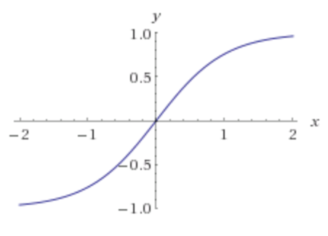
Honer Scheme & Tanh(x) approximation
"Speed Improvement of the Back-Propagation on Current Generation Workstations" by D. Anguita, G. Parodi and R. Zunino
x | f(x)
x > 1.92033 | .96016
0 < x <= 1.92033 | -.26037x² + .999993x + .00000206278
-1.92033 < x < 0 | .26037x² - .999993x - .00000206278
x < -1.92033 | -.96016
x | f(x)
x > 1.920318603515625 | 0.9601593017578125
0 < x <= 1.920318603515625 | -0.2603607177734375x² +0.999969482421875x + 0
-1.920318603515625 < x < 0 | 0.2603607177734375x² +0.999969482421875x - 0.
x < -1.920318603515625 | -0.9601593017578125

Slide 29
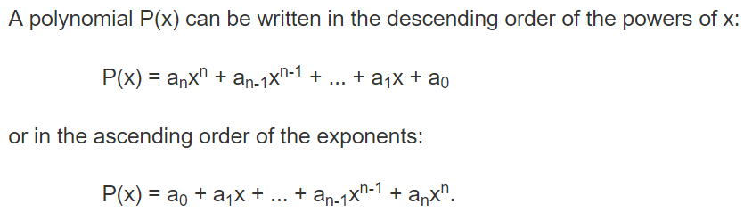
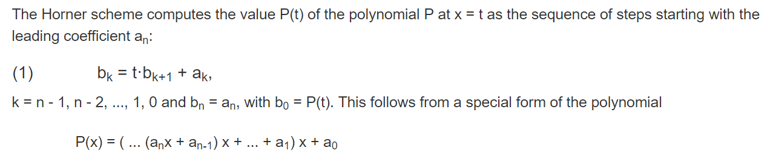
Honer Scheme & Tanh(x) approximation
http://www.cut-the-knot.org/Curriculum/Calculus/HornerMethod.shtml

Slide 30
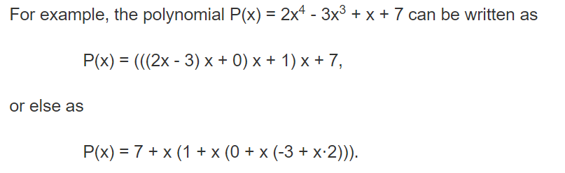
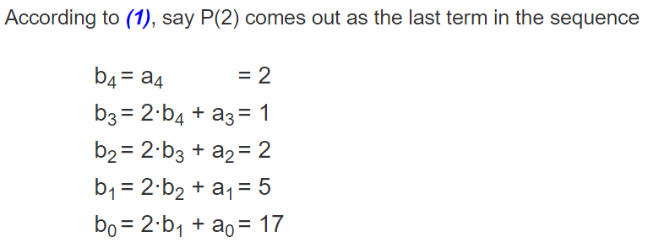
Honer Scheme & Tanh(x) approximation
http://www.cut-the-knot.org/Curriculum/Calculus/HornerMethod.shtml

Slide 31
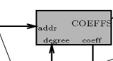
COEFFS
Gives coefficient values of polynomial for Honer Scheme
Coefficients vary based on range and current degree
Numbers are fixed point
1 sign bit
3 integer bits
16 fractional bits
Possible Speedups
Simply output -0.9601593017578125 or 0.9601593017578125 when on edges
Would require control signal to turn off COEFFS and CNT
S | int | int | int | .f | f | f | f | f | f | f | f | f | f | f | f | f | f | f | f

Slide 32
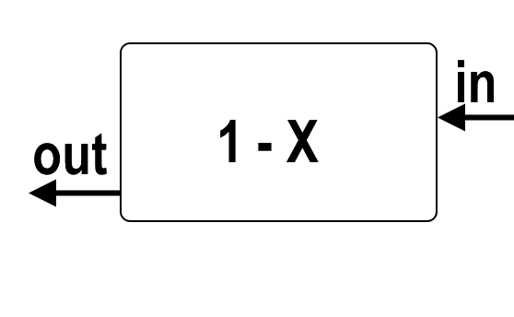
1 - X
Self explanatory
Takes an input, subtracts it from 1, and sends it out
Since we are using fixed point numbers, and have decided on 16 fractional bits (out of 20 bits), 1 is written as 00010000000000000000
Output <= 00010000000000000000 - Input

Slide 33
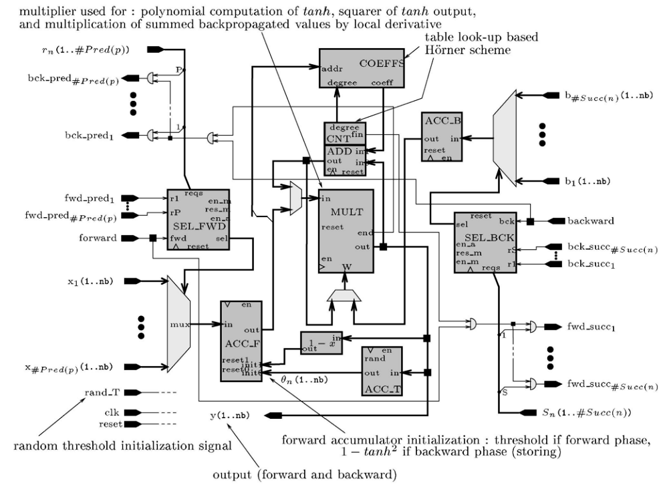
Activator steps
Initialize Threshold (bias)
2. Accumulate forward inputs
3. Activate (Multiply)
4. Update Threshold weight
5. Calculate tanh(x)²
6. Calculate Activator Error

Slide 34
State Machine
Init
Accumulate
En_m = 1
All acknowledge
Back Prop
Forward
Activate
Threshold Update

Slide 35
High Level Diagram (Lazy)
ACC_F <- ACC_T
ACC_F <- ACC_F + X
En_m = 1
All acknowledge
Back Prop
Forward
Activate
Threshold Update

Slide 36
Forward Active & Threshold Update & Back Prop
Forward Activation
F’(x)
MULT <- ACC_F & ADD;
CNT <- CNT + 1
MULT <- ADD & ADD
Fin != 0
ADD <- MULT + COEFF
ACC_F <- 1-x (MULT)
Fin = 1
ADD <- MULT
ACC_F <- ACC_T
MULT <- ACC_F & ACC_B
Backward = 1
MULT_END = 1
MULT WAIT
ACK

Slide 37
Neuron
North L
East Ports
West L
West Ports
ACT
East L
South Ports

Slide 38
Corner Neuron & Output Neuron
Omitted East or North Link
Corner Neuron
Output Neuron
North L
East Ports
East Ports
West L
West L
West Ports
ACT
West Ports
East L
ACT
South Ports
South Ports

Slide 39
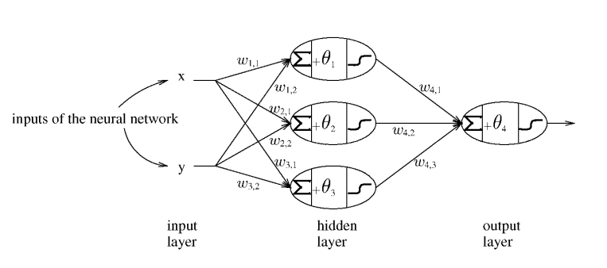
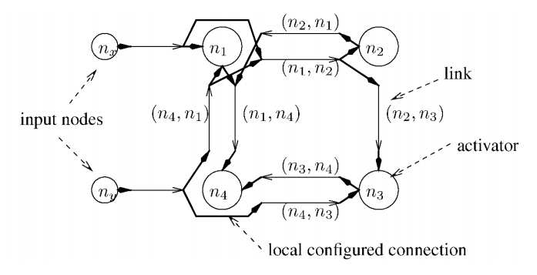
Standard Network
Hidden Layer
Input Layer
Output Layer
Input Node
Hidden Neuron
Output Neuron
Input Link
1
Standard Link
1
4
Activation Link
3
4
2
2
3
5
2
5
3
3
3
2
1
4
1
2
4
6
10 Links
6 stages to activation
9 Links
5 stages to activation

Slide 40
Standard Network
Input Node
Network Control Unit
Hidden Neuron
UART
Output Neuron
Forward
Backward
Still_FWD
Input Link
Standard Link
Error
Activation Link

Slide 41
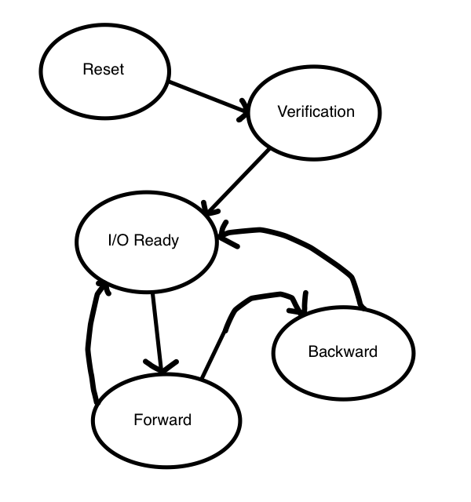
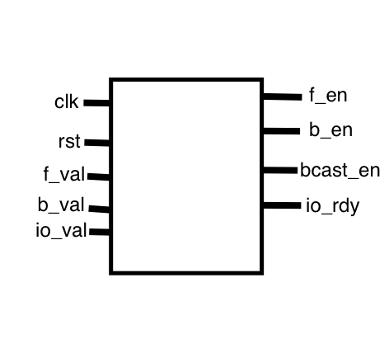
Control Unit
Determines current state and outputs respective enable signals
Reset, Verification, Forward, Backward, and I/O Ready

Slide 42

I/O Module (via UART Communication)
Added additional data buses and increased size of all data buses from 7 bits to 20 bits
Three data buses from PC to FPGA and one data bus from FPGA to PC
Added 7 segment display code
More (aggressive) testing to be done this weekend

Slide 43

Error Module
Calculates the error in the calculated result based on the classification value
Classification value is passed in from RAM

Slide 44


System Overview
UART
Configuration
Neural Network
Training Set
Learning
Validation
Classification

Slide 45
XOR Network
Proof of Concept

Slide 46


XOR Function Challenge

Slide 47

XOR Resource Usage (Without control unit & Error module)
Minimum period: 4.400ns (Maximum Frequency: 227.252MHz)

Slide 48


Neuron FPGA Resources Estimates
Before
Minimum Period: 4.634ns (Max Clock 215 MHz)
Max Combinational Path Delay 1.154ns
After
Minimum period: 5.282ns (Maximum Frequency: 189.317MHz)
Maximum combinational path delay: 1.368ns

Slide 49
Future Development
Expanding the network

Slide 50


Brick Design

Slide 51





Bricks can be assembled into Neural Networks

Slide 52
They can be used to make quite large networks

Slide 53


Training Sets
Iris Training Set
MNIT Training Set
3 classes of Iris Flowers
4 attributes
Easily normalized
150 Samples
Larger than XOR
But Simple
Nonlinear
Ten digits
28 x 28 pixels
~784 attributes
60,000 training samples
Extremely large
Annoying to format

Slide 54
Iris Network
Input Node
Hidden Neuron
Max
Output Neuron
Input Link
Standard Link
Activation Link
3 classes of Iris Flowers
4 attributes
Easily normalized
150 Samples
Larger than XOR
But Simple
Nonlinear
Output Layer
Hidden Layer 1
Hidden Layer 2

Slide 55

Any
Questions?

